Slide 1

What is Real-Time system?
A system in which the correctness of the computation not only depends upon the logical correctness of the computation but also upon the time at which the result is produced.
Computation is performed during the actual time that an external process occurs, in order that the computation results may be used to control, monitor, or respond in a timely manner to the external process
A real-time system responds in a (timely) predictable way to unpredictable external stimuli arrivals

Slide 2
What is Hard RealTime?
A system where all the critical tasks are highly deterministic.
Late response is considered to be a wrong response. Hence all the real time tasks not only produce logically correct result, but also their delivery time is predictable.
OS used in Mission-critical systems, like automotive, avionics, space missions, medical equipment are supposed to be hard real time.

Slide 3
What is Soft-realtime
A system where miss in task deadline is not a Catastrophe(disaster / Hazard), but possible a reduction in quality.
Home appliance, real video streaming, set-top box (in DTH ) in television,mobile phones,etc.

Slide 4
Features of RTOS?
Occupy very less memory
Consume fewer resources
Response times are highly predictable
Unpredictable environment
The Kernel saves the state of the interrupted task and then determines which task it should run next.
The Kernel restores the state of the task and passes control of the CPU for that task.

Slide 5
Factors for selecting an RTOS?
  Here, are essential factors that you need to consider for selecting RTOS:
  Performance: Performance is the most important factor required to be considered while selecting for a RTOS.
  Middleware: if there is no middleware support in Real time operating system, then the issue of time-taken integration of processes occurs.
  Error-free: RTOS systems are error-free. Therefore, there is no chance of getting an error while performing the task.
  Embedded system usage: Programs of RTOS are of small size. So we widely use RTOS for embedded systems.
  Maximum Consumption: we can achieve maximum Consumption with the help of RTOS.
  Task shifting: Shifting time of the tasks is very less.
  Unique features: A good RTS should be capable, and it has some extra features
  like how it operates to execute a command, efficient protection of the memory of the system, etc.

Slide 6
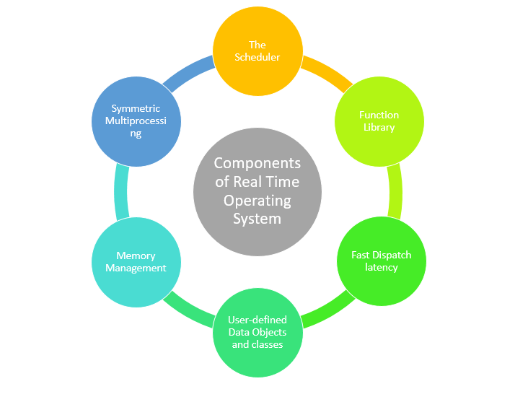
Components of RTOS?

Slide 7
What makes OS a RTOS?
Has to be ROMable preferably
Has to be scalable preferably
Has to configurable
Has to be preferably deterministic
Has to be multi-threaded and preemptive.
Scheduling of multiple threads must be preferably priority based, can use round-robin, or cooperative scheduling also.
Should provide predictable thread synchronization.

Slide 8
Priority Inheritance must exist through dynamic priority management.
Interrupt Latency , Interrupt Response and Interrupt Recovery must be calculable.
Every system call’s maximum time of completion should provided/known for a given target’s specification.
System interrupt levels and driver IRQ levels must be known to the developer of the system.

Slide 9
What is Reentrant function?
A function/Sub-routine when invoked simultaneously or nested or interleaved should not interfere with each other.
Shares same copy of code but different copies of data for protection.
Usually use local variables. Global and static variables are discouraged.
Particularly useful in implementation of recursive functions and Interrupt handling.

Slide 10
What is Porting of RTOs ?
RTOS contains two parts:
one is processor specific codes & another one is processor independent codes.
Porting means write the above two parts in to your device which is going to be ported & change the processor specific codes in order to support the independent part of RTOS code.

Slide 11
Porting is divided into two types:
1. Architecture Porting which ports the context switch and interrupts to the OS
2. Board porting which is concerned to board support package and device drivers.

Slide 12
What is BSP?
A Platform dependent package (in form of source code or binary files) provided by RTOS developers to build the RT-Kernel on a Customized hardware platform .
Sometimes it is a collection of drivers and HALs (Hardware Abstraction Layer).
It also largely depends on OEM’s (Original Equipment Manufacturer) hardware specification.

Slide 13
In embedded systems, a board support package (BSP) is the layer of software containing hardware-specific boot firmware and device drivers and other routines that allow a given embedded operating system, for example a real-time operating system (RTOS), to function in a given hardware environment .
The purpose of a BSP is to abstract the hardware details and provide a standardized interface for the operating system or firmware to interact with the target board. It simplifies the development process by providing ready-to-use software components and drivers, allowing developers to focus on writing application-level code rather than dealing with low-level hardware initialization and configuration.

Slide 14
BSP includes the following components like:
Hardware Initialization
Device drivers
Interrupt Handling
Power management
memory management

Slide 15
What is TCB?
A Task’s context need to be saved when context switch occurs in a multi-tasking environment.
The data structure for saving is called as Task Control Block or TCB.
TCB mainly contains the following
  Thread ID of execution, that is, the task's program counter
  the CPU registers and (optionally) floating-point registers
  a stack for dynamic variables and function calls
  I/O assignments for standard input, output, and error
  a delay timer
  a time-slice timer
  kernel control structures
  signal handlers
  debugging and performance monitoring values

Slide 16
A Task Control Block (TCB) is a data structure used by an operating system or a real-time operating system (RTOS) to manage and control individual tasks or threads. It contains information about the state, context, and control parameters of a task, allowing the operating system to schedule and switch between tasks efficiently.
The TCB typically includes the following components:
Task state
Program Counter
Stack pointer
Task priority
Task Identification
Resource management
Task-specific data

Slide 17
When a task is created, the operating system typically allocates memory for the TCB and initializes its fields based on the task's configuration. During task scheduling and context switching, the operating system uses the TCB to save the current task's context and load the context of the next task to be executed. This allows for seamless task switching and ensures that each task can resume its execution from where it left off.
The TCB is a critical data structure in multitasking systems, as it provides the necessary information for task management, scheduling, and context switching. By maintaining a TCB for each task, the operating system can efficiently manage and control the execution of concurrent tasks or threads.

Slide 18
What is Critical Section?
A section of code in a program , while executing , no other program should execute.
All interrupts must be disabled while Critical Section code is executing including the Scheduler interrupt.

Slide 19
What is a Deadlock/Deadly Embrace?
A deadlock is a situation wherein two or more task are waiting fo resources held by the each other.

Slide 20
Necessary Conditions for Deadlock?
Mutual exclusion: resources cannot be shared.
Hold and wait: processes request resources incrementally, and hold on to what they've got.
No preemption: resources cannot be forcibly taken from processes.
Circular wait: circular chain of waiting, in which each process is waiting for a resource held by the next process in the chain.

Slide 21
Strategies for dealing with Deadlock
Ignore the problem altogether.
detection and recovery
avoidance by careful resource allocation
prevention by structurally negating one of the four necessary conditions.

Slide 22
Deadlock Avoidance
Acquire all resources before proceeding
Acquire resource in an order and release in reverse order
Change priorities dynamically if required & possible
enable watch dog timer as an anticipation for dead lock.

Slide 23
Interrupts
Hardware mechanism to inform the CPU that an asynchronous event has occurred
The ISR processes the event and returns to
  the background in a foreground/ background system
  the interrupted task for a non preemptive kernel
  the highest priority task ready to run for a preemptive kernel
Notes:
We will have a closer look at the interrupts which are the key to real time programming. The processors can process the events as they occur if they are working through interrupts.This avoids the processor wasting its time in polling an event.

Slide 24
Interrupt Timings
TIME
Context
saved
Context
restored
TASK
Background
Interrupt
Latency
User ISR code
Interrupt
Request
ISR
Interrupt
Recovery
Interrupt Response
Notes:
The figure explains the various interrupt latency,interrupt recovery and interrupt response timings for a foreground / background method and a non preemptive kernel.

Slide 25
Interrupt Timings
TIME
Context
saved
ISR entry
function
ISR exit
function
Context
restored
TASK A
Task A
Interrupt
Latency
User ISR code
Interrupt
Request
ISR
Interrupt
Recovery
Interrupt Response
Task B
Interrupt
Recovery
Notes:
The figure explains the various interrupt latency,interrupt recovery and interrupt response timings for a preemptive kernel.Here,after the ISR is served,the kernel can return back to the interrupted task or to a higher priority task that was made ready by the ISR.The interrupt recovery time in the latter case is going to be more as the context switch is going to take more time.

Slide 26
Interrupt Latency
Interrupt latency is the sum of the maximum amount of time interrupts are disabled and the time to start executing the first instruction in the ISR.
The longer the interrupts are disabled, the higher the interrupt latency.
Notes:
Interrupt latency is processor specific. But the real time kernel suppliers will have to provide the details about these timings along with the other specifications.

Slide 27
Interrupt Response
Time between the reception of the interrupt and the start of the user code that handles the interrupt
For a foreground background system and non preemptive kernel = interrupt latency + time to save the CPU’s context
For a preemptive kernel = interrupt latency + the time to save the CPU’s context + execution time of the kernel ISR entry function
Notes:
Also known as the response time. Normally,once the processor is interrupted,it saves its program counters and associated segment registers (context) and enters into the ISR.Preemptive kernel,on the other hand calls a special function which notifies to the kernel that an ISR is in progress and lets the kernel to keep track of interrupt nesting.In MicroC/OS-II it is the function OSIntEnter().

Slide 28
Interrupt Recovery
Time required for the processor to return to the interrupted code
For a foreground/background system and non preemptive kernel = time to restore the CPU’s context + time to execute the return from interrupt instruction
For a preemptive kernel = time to determine if a higher priority task is ready + time to restore the CPU’s context of the highest priority task + time to execute the return from interrupt instruction
Notes:
In a preemptive kernel,a function [OSIntExit()] is called.This function allows the kernel to determine whether all interrupts have nested.If they have nested,the kernel determines if a higher priority task has been made ready to run as a result of the ISR.If so,it will run that task.Hence,we see that the interrupted task will only resume when it becomes the highest priority task ready to run.

Slide 29
Priority Inversion Problem
Priority inversion is an undesirable situation in which a higher priority task gets blocked (waits for CPU) for more time than that it is supposed to, by lower priority tasks.
Example:
Let T₁ , T₂ , and T₃ be the three periodic tasks with decreasing order of priorities.
Let T₁ and T₃ share a resource “S”.

Slide 30

Priority Inversion example
A higher priority task waits for a lower priority task
Makes a request for resource S and gets blocked
Resource S is available and T1 is scheduled here
T1
Highest priority
T₁
T₁
T2 completes
Preempted by higher priority task T1
L1
T₂
T3 completes
T2
T3 is the only active task
Medium priority
Preempted by higher priority task T2
K3
K1
K2
T3
T₃
T₃
T₃
Least priority
0
T1 and T3 share resource S
Total blocking time for task T1 = (K1+K2+K3) + (L1)

Slide 31
Priority Inversion - Real-world Example
Mars Pathfinder mission (July 4, 1997)
VxWorks (real-time OS), preemptive priority scheduling of threads (e.g., RMS)
Priority inversion involving three threads:
  Information bus task (T1), meteorological data gathering task (T3), communication task (T2). Priority order: T1>T2>T3
  Shared resource: information bus (used mutex)
Same situation as described in the previous example had occurred
Findings: Priority ceiling protocol was found to be disabled initially, then it was enabled online and the problem was corrected

Slide 32
What is meant by a jitter ?
Timing error of a task over subsequent iterations of a program or loop is referred to as jitter.
Hard RTOS are optimized to minimize jitter the most.

Slide 33
What is a clock tick ?
A clock tick is a special interrupt that occurs periodically. This interrupt can be viewed as the system's heartbeat.
The time between interrupts is application specific and is generally between 10 and 200 mS.

Slide 34
The clock tick interrupt allows a kernel to delay tasks for an integral number of clock ticks and to provide timeouts when tasks are waiting for events to occur.
The faster the tick rate, the higher the overhead imposed on the system.

Slide 35
Types of RTOs

Slide 36

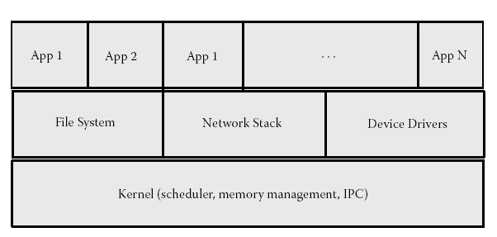

Slide 37
Traditional RTOs
Were meant for MMU-less, restricted on chip/off chip memory processors.
Supports flat/linear address space with no memory protection between the kernel and applications,
Have small memory and size footprint as both the OS and applications are bundled into a single image.
All software running on the system should be foolproof.

Slide 38
There is no overhead of system calls, message passing, or copying of data.
Applications or kernel modules cannot be dynamically added to the system.

Slide 39
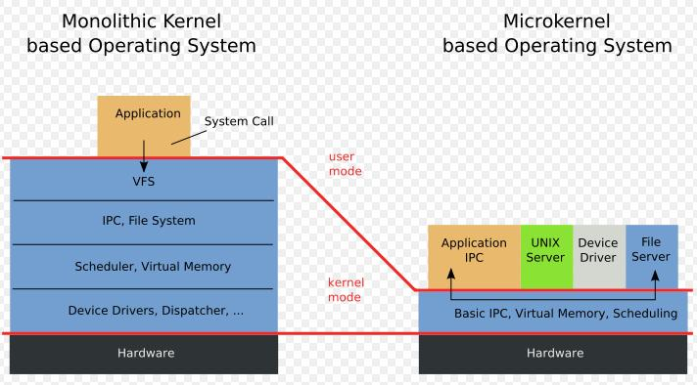

Slide 40
What is a micro kernel ?
Suited for processors having MMU/MMU less.
If CPU supports modes, the micro kernel is the only software executing at most privileged level (supervisor/kernel mode).
The microkernel makes use of a small OS that provides the very basic service (scheduling, interrupt handling, message passing)
And the rest of the kernel subsystem (file system, device drivers, networking stack) runs as applications in user space.

Slide 41
Must support well-defined APIs for communication with the OS as well as robust message-passing schemes.

Slide 42
What is Monolithic Kernel ?
Clear Distinction between the user and kernel space.
User space normally cannot access the system hardware nor can it execute privileged instructions.
Using special entry points (provided by hardware), an application can enter the kernel mode from user space.
User space programs operate on a virtual address hence corruption of another application’s or the kernel’s memory avoided.
Support dynamic loading of separately compiled kernel modules or applications without bringing down the system.

Slide 43
Few more questions
Explain what is scalable and configurable feature in RTOS.
Why the virtual memory may be absent in RT Kernels?
What is advantage if virtual memory is absent ?
What is the advantage of Micro-kernel?
How to reduce latency?
What is priority inheritance?
What is priority inversion ?
What is watchdog timer?
What is clock tick of an RTOs ?
What is a task, resource, context switching… ?

